Slide 1
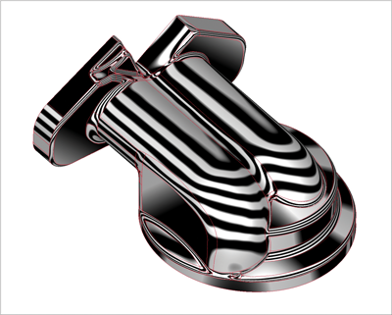
Part Document – Advanced Topics
Presenter
Developer Technical Services

Slide 2
Agenda
iFeatures
Creation
Insertion
Table-driven iFeatures
Derived Components
iParts
Member Creation
WorkSheet access
Multiple Solid Bodies
Creation
Related Features

Slide 3
iFeatures
Workflow:
Create iFeatureDefinition object for the desired .ide file.
Set the various inputs.
iFeatureInput [Base class]
iFeatureParameterInput
iFeatureEntityInput
iFeatureSketchPlaneInput
iFeatureWorkPlaneInput
iFeatureVectorInput
3. Use the iFeatureDefinition to create the iFeature.

Slide 4
iFeatures Redesign
Redesign of iFeatures for ease of use in Inventor 2009
Old Interface is still present, but hidden and we do not support
Notes:
The API interface for iFeatures has been redesigned to make them easier understand and use. For backward compatibility, the old interface still works but has been hidden. With the new interface, an iFeature is like all other parts features; it is represented by a single object and is accessible from the PartFeatures collection.
In addition to simplifying the iFeature interface, support for table driven iFeatures has also been added.
To help with performance there is now the ability to batch suppress and unsuppress a list of features.
The extrude command now supports the ability to extrude to a point. This is also supported through the API.

Slide 5
iFeature Example (1/2)
Public Sub iFeatureInsertion()
Dim oCompDef As PartComponentDefinition
oCompDef = _InvApplication.ActiveDocument.ComponentDefinition
Dim oTG As TransientGeometry
oTG = _InvApplication.TransientGeometry
' Arbitrarily get the start face of the first extrusion.
Dim oFace As Face
oFace = oCompDef.Features.ExtrudeFeatures.Item(1).EndFaces.Item(1)
' Create the definition object for the specified ide file.
Dim oideFile As String = OpenFile("(*.ide)|*.ide")
' Create the definition object for the specified ide file.
If (String.IsNullOrEmpty(oideFile)) Then
MessageBox.Show("no ide file is selected!")
Exit Sub
End If

Slide 6
iFeature Example (2/2)
Dim oiFeatDef As iFeatureDefinition
oiFeatDef = oCompDef.Features.iFeatures.CreateiFeatureDefinition(oideFile)
' Set the iFeature input values.
Dim oiFeatInput As iFeatureInput
Dim oParamInput As iFeatureParameterInput
For Each oiFeatInput In oiFeatDef.iFeatureInputs
Select Case oiFeatInput.Name
Case "Sketch Plane"
Dim oPlaneInput As iFeatureSketchPlaneInput
oPlaneInput = oiFeatInput
oPlaneInput.PlaneInput = oFace
Call oPlaneInput.SetPosition(oTG.CreatePoint(5, 5, 0.1), oTG.CreateVector(1, 0, 0), 0)
Case "Diameter"
oParamInput = oiFeatInput
oParamInput.Expression = ".7 in"
Case "Height"
oParamInput = oiFeatInput
oParamInput.Expression = "10.0 in"
Case "Radius"
oParamInput = oiFeatInput
oParamInput.Expression = ".5 in"
End Select
Next
' Create the iFeature.
Call oCompDef.Features.iFeatures.Add(oiFeatDef)
End Sub
Notes:
'/////////////////////////////////////////////////////////////////////////////////////////////////////////////
'// Sample
'//
'// Use: iFeature Insertion
'/////////////////////////////////////////////////////////////////////////////////////////////////////////////
Public Sub iFeatureInsertion()
Dim oCompDef As PartComponentDefinition
Set oCompDef = ThisApplication.ActiveDocument.ComponentDefinition
Dim oTG As TransientGeometry
Set oTG = ThisApplication.TransientGeometry
' Arbitrarily get the start face of the first extrusion.
Dim oFace As Face
Set oFace = oCompDef.Features.ExtrudeFeatures.Item(1).EndFaces.Item(1)
' Create the definition object for the specified ide file.
Dim oiFeatDef As iFeatureDefinition
Set oiFeatDef = oCompDef.Features.iFeatures.CreateiFeatureDefinition( _
"C:\Program Files\Autodesk\Inventor 2009\Catalog\Geometric Shapes\Cone_Rounded.ide")
' Set the iFeature input values.
Dim oiFeatInput As iFeatureInput
Dim oParamInput As iFeatureParameterInput
For Each oiFeatInput In oiFeatDef.iFeatureInputs
Select Case oiFeatInput.Name
Case "Sketch Plane"
Dim oPlaneInput As iFeatureSketchPlaneInput
Set oPlaneInput = oiFeatInput
oPlaneInput.PlaneInput = oFace
Call oPlaneInput.SetPosition(oTG.CreatePoint(5, 5, 0.1), oTG.CreateVector(1, 0, 0), 0)
Case "Diameter"
Set oParamInput = oiFeatInput
oParamInput.Expression = ".7 in"
Case "Height"
Set oParamInput = oiFeatInput
oParamInput.Expression = "10.0 in"
Case "Radius"
Set oParamInput = oiFeatInput
oParamInput.Expression = ".5 in"
End Select
Next
' Create the iFeature.
Call oCompDef.Features.iFeatures.Add(oiFeatDef)
End Sub

Slide 7
Table-Driven iFeatures
iFeatureDefinition supports for table-driven iFeatures
iFeatureDefinition. IsTableDriven
ActiveTableRow
iFeatureTable
DefaultRow
iFeatureTableColumns
iFeatureTableColumn
iFeatureTableCell
iFeatureTableRows
iFeatureTableRows
iFeatureTableCell
Notes:
Public Sub PlaceTableDriveniFeature()
' Get the part document and component definition of the active document.
On Error Resume Next
Dim oPartDoc As PartDocument
Set oPartDoc = ThisApplication.ActiveDocument
If Err Then
MsgBox "A part must be active."
Exit Sub
End If
Dim oPartDef As PartComponentDefinition
Set oPartDef = oPartDoc.ComponentDefinition
' Get the selected face to use as input for the iFeature.
Dim oFace As Face
Set oFace = oPartDoc.SelectSet.Item(1)
If Err Then
MsgBox "A planar face must be selected."
Exit Sub
End If
On Error GoTo 0
If oFace.SurfaceType <> kPlaneSurface Then
MsgBox "A planar face must be selected."
Exit Sub
End If
Dim oFeatures As PartFeatures
Set oFeatures = oPartDef.Features
' Create an iFeatureDefinition object.
Dim oiFeatureDef As iFeatureDefinition
Set oiFeatureDef = oFeatures.iFeatures.CreateiFeatureDefinition( _
"C:\Program Files\Autodesk\Inventor 2010\Catalog\Table\Test.ide")
' Set the input, which in this case is only the sketch plane
' since the other input comes from the table. The parameter input
' should not be available at this point since it can't be changed
' and is controlled by the table.
'
' When an existing table driven iFeature is accessed then this should
' include the parameters so the programmer has access to the corresponding
' reference parameter that's created.
Dim bFoundPlaneInput As Boolean
bFoundPlaneInput = False
Dim oInput As iFeatureInput
For Each oInput In oiFeatureDef.iFeatureInputs
Dim oParamInput As iFeatureParameterInput
Select Case oInput.Name
Case "Profile Plane1"
Dim oPlaneInput As iFeatureSketchPlaneInput
Set oPlaneInput = oInput
oPlaneInput.PlaneInput = oFace
bFoundPlaneInput = True
End Select
Next
If Not bFoundPlaneInput Then
MsgBox "The ide file does not contain an iFeature input named ""Profile Plane1""."
Exit Sub
End If
'** Look through the table to find the row where "Size" is "4.5".
Dim oTable As iFeatureTable
Set oTable = oiFeatureDef.iFeatureTable
' Find the "Size" column.
Dim oColumn As iFeatureTableColumn
Dim bFoundSize As Boolean
bFoundSize = False
For Each oColumn In oTable.iFeatureTableColumns
If oColumn.DisplayHeading = "Size" Then
bFoundSize = True
Exit For
End If
Next
If Not bFoundSize Then
MsgBox "The column ""Size"" was not found."
Exit Sub
End If
' Find the row in the "Size" column with the value of "4.5"
Dim oCell As iFeatureTableCell
bFoundSize = False
For Each oCell In oColumn
If oCell.Value = "4.5" Then
bFoundSize = True
Exit For
End If
Next
If Not bFoundSize Then
MsgBox "The cell with value ""4.5"" was not found."
Exit Sub
End If
' Set this row as the active row.
oiFeatureDef.ActiveTableRow = oCell.Row
' Create the iFeature.
Dim oiFeature As iFeature
Set oiFeature = oFeatures.iFeatures.Add(oiFeatureDef)
End Sub

Slide 8
Derived Parts and Assemblies
Workflow:
Create the definition corresponding to the desired type of derived part or assembly.
Set the various inputs.
Use the definition to create the derived component.

Slide 9
Derived Part Example
Public Sub DerivedPartExample()
Dim oCompDef As PartComponentDefinition
oCompDef = _InvApplication.ActiveDocument.ComponentDefinition
Dim oDerivedPartComps As DerivedPartComponents
oDerivedPartComps = oCompDef.ReferenceComponents.DerivedPartComponents
'derive from the sample Part1.ipt
'1. Create the definition corresponding to the desired
' type of derived part or assembly
Dim oDerivedPartDef As DerivedPartUniformScaleDef
oDerivedPartDef = oDerivedPartComps.CreateUniformScaleDef( _
"C:\Temp\Part1.ipt")
'2. Set the various inputs.
oDerivedPartDef.ScaleFactor = 0.75
' 3. Use the definition to create the derived component.
Dim oDerivedComp As DerivedPartComponent
oDerivedComp = oDerivedPartComps.Add(oDerivedPartDef)
End Sub

Slide 10
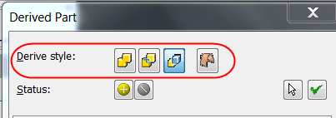
Derived Parts
Not requier a ‘‘blank’’ document state
Can select Bodies to derive
Use for inserting part or assembly into a part
DerivedPartDefinition.DeriveStyle Property
kDeriveAsSingleBodyWithSeams
kDeriveAsSingleBodyNoSeams
kDeriveAsMultipleBodies
kDeriveAsWorkSurface.
Notes:
The Derive command contains powerful new features to support multibody parts.
A derived part no longer requires a "blank" document state.
You can use the Derive command to insert parts or assemblies into a part file as:
1. A single solid body with merged seams
2. A single solid body with seams (retains component colors)
3. Maintain each solid as a solid body (all parts become "bodies")
4. A single composite surface
'///////////////////////////////////////////////////////////////////////////////////////////////////////
'// Use: Derive part with DeriveStyle control
'//
'//
'///////////////////////////////////////////////////////////////////////////////////////////////////////
Public Sub CreateDerivedPart()
Dim oCompDef As PartComponentDefinition
Set oCompDef = ThisApplication.ActiveDocument.ComponentDefinition
Dim oDerivedPartComps As DerivedPartComponents
Set oDerivedPartComps = oCompDef.ReferenceComponents.DerivedPartComponents
Dim oDerivedPartDef As DerivedPartUniformScaleDef
Set oDerivedPartDef = oDerivedPartComps.CreateUniformScaleDef("C:\Documents and Settings\leefsmp\Desktop\PartRef.ipt")
oDerivedPartDef.ScaleFactor = 0.75
'oDerivedPartDef.ExcludeAll
'oDerivedPartDef.IncludeAlliMateDefinitions
'oDerivedPartDef.IncludeAllSurfaces
oDerivedPartDef.IncludeAll
Dim oDerivedEntity As DerivedPartEntity
For Each oDerivedEntity In oDerivedPartDef.parameters
If (TypeOf oDerivedEntity.ReferencedEntity Is Parameter) Then
Dim oParameter As Parameter
Set oParameter = oDerivedEntity.ReferencedEntity
Debug.Print "Derived Parameter: " & oParameter.Name
'oDerivedEntity.IncludeEntity = False
End If
Next
oDerivedPartDef.DeriveStyle = kDeriveAsSingleBodyNoSeams
Dim oDerivedComp As DerivedPartComponent
Set oDerivedComp = oDerivedPartComps.Add(oDerivedPartDef)
End Sub

Slide 11
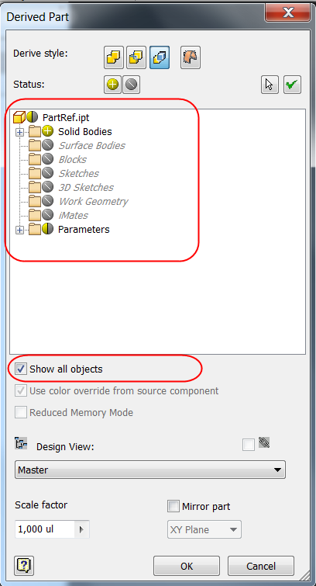
Derived Part/Assembly
Individually include/exclude parameters and iMates
Map B-Rep Faces between derived result and original
Face.ReferencedEntity
oDerivedPartDef.ExcludeAll()
oDerivedPartDef.IncludeAlliMateDefinitions
oDerivedPartDef.IncludeAllSurfaces
Dim oDerivedEntity As DerivedPartEntity
For Each oDerivedEntity In oDerivedPartDef.Parameters
If (TypeOf oDerivedEntity.ReferencedEntity Is Parameter) Then
Dim oParameter As Parameter
oParameter = oDerivedEntity.ReferencedEntity
Debug.Print("Derived Parameter: " & oParameter.Name)
'oDerivedEntity.IncludeEntity = False
End If
Next
Notes:
The interface to derived parts supports some additional capability to control using parameters and iMates. There is also support to control scaling and mirroring when creating a derived assembly.
Can map faces from the derived result to the original part using the Face.ReferencedEntity property.

Slide 12
iParts - API Support
Query access to iPart factory table.
Access to spreadsheet so you can use the Excel API for edit.
Creation of iPart members.
Placement of iPart members within an assembly.
Turn a “normal” part into an iPart.

Slide 13
iPartFactory Object
Use PartComponentDefinition.IsiPartFactory to determine if the part is a Factory or use PartComponentDefinition.CreateFactory to turn it to iPart.
Use PartComponentDefinition.iPartFactory to access it.
iPartFactory provides access to the iPartTable, the Excel sheet and member creation:
DefaultRow Property
TableColumns Property
TableRows Property
ExcelWorkSheet Property
CreateMember / CreateCustomMember Methods

Slide 14
iPartMember Object
Use PartComponentDefinition.IsiPartMember to determine if the part is an iPart Member.
Use PartComponentDefinition.iPartMember to access the iPartMember Object.
iPartMember allows you for example to retrieve the factory object it was created from or break the link with it:
ParentFactory Property
BreakLinkToFactory Method

Slide 15
iParts - Create and Edit Member
Public Sub placeAndSwitchiPartSample()
Dim oAsmDoc As AssemblyDocument
oAsmDoc = _InvApplication.ActiveDocument
' Place an iPart member using the member name.
'assume the iPart factory has more than 3 rows
Dim oOcc As ComponentOccurrence
oOcc = oAsmDoc.ComponentDefinition.Occurrences.AddiPartMember( _
"C:\My Documents\Inventor\iPartFactory.ipt", _
_InvApplication.TransientGeometry.CreateMatrix, "iPartFactory-02")
' Change the instance to another member using the member name.
oOcc.ChangeRowOfiPartMember("iPartFactory-03")
' Change the instance to another member using the index in the table.
oOcc.ChangeRowOfiPartMember(1)
End Sub

Slide 16
iParts - Generate Members
Public Sub CreateAndMoveMember()
Dim oFactoryDoc As PartDocument
oFactoryDoc = _InvApplication.Documents.Open("C:\Temp\Factory1.ipt")
Dim oFactory As iPartFactory
oFactory = oFactoryDoc.ComponentDefinition.iPartFactory
Dim oMember As iPartMember
oMember = oFactory.CreateMember(1)
'The Member is generated in the Factory.MemberCacheDir
Dim SrcFilename As String
SrcFilename = oFactory.MemberCacheDir + "\" + oMember.Name
Dim DestFilename As String
DestFilename = "C:\Temp\" + "NewMember1.ipt"
_InvApplication.FileManager.CopyFile(SrcFilename, DestFilename)
'Delete the original file, if you'd like to
_InvApplication.FileManager.DeleteFile(SrcFilename)
End Sub

Slide 17
iPart Excel WorkSheet Access
Public Sub WorkSheetAccess()
Dim oFactoryDoc As PartDocument
oFactoryDoc = _InvApplication.ActiveDocument
'get ipart factory
Dim oFactory As iPartFactory
oFactory = oFactoryDoc.ComponentDefinition.iPartFactory
'get corresponding excel file
'make sure Excel reference is added
Dim oWorksheet As Excel.WorkSheet
oWorksheet = oFactory.ExcelWorkSheet
'Do some modification to the Worksheet
Dim oWorkbook As Excel.Workbook
oWorkbook = oWorksheet.Parent
Dim oXlsApp As Excel.Application
oXlsApp = oWorkbook.Parent
'save the change
oWorkbook.Save()
oWorkbook.Close()
oWorksheet = Nothing
oWorkbook = Nothing
End Sub
Notes:
Public Sub AddRow()
Dim oFactoryDoc As PartDocument
Set oFactoryDoc = ThisApplication.ActiveDocument
Dim oFactory As iPartFactory
Set oFactory = oFactoryDoc.ComponentDefinition.iPartFactory
Dim oWorksheet As WorkSheet
Set oWorksheet = oFactory.ExcelWorkSheet
Dim newRowIndex As Long
newRowIndex = oFactory.TableRows.Count + 2
'Write new row values
oWorksheet.Cells(newRowIndex, 1) = "Factory1-04"
oWorksheet.Cells(newRowIndex, 2) = "Factory1-04"
oWorksheet.Cells(newRowIndex, 3) = "15 mm"
oWorksheet.Cells(newRowIndex, 4) = "15 mm"
oWorksheet.Cells(newRowIndex, 5) = "5 mm"
Dim oWorkbook As Workbook
Set oWorkbook = oWorksheet.Parent
Dim oXlsApp As Excel.Application
Set oXlsApp = oWorkbook.Parent
oWorkbook.Save
oWorkbook.Close
Set oWorksheet = Nothing
Set oWorkbook = Nothing
'Set our new row as default
oFactory.DefaultRow = oFactory.TableRows(newRowIndex - 1)
oFactoryDoc.Save
'oFactoryDoc.close
End Sub

Slide 18
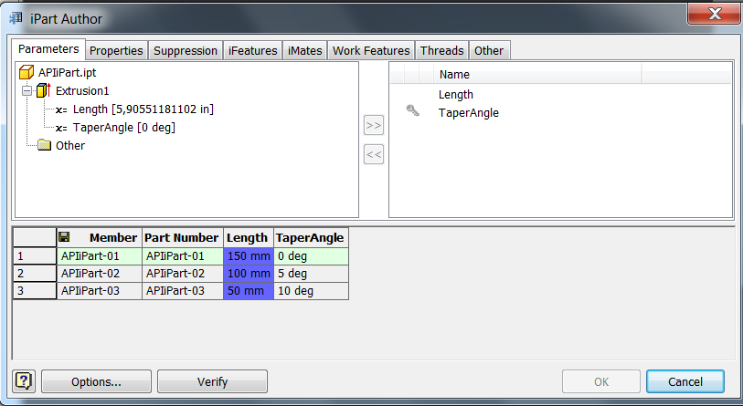
Lab: iPart Creation
Programmatically create from scratch an iPart with a iTable that looks like this for example:
Notes:
Tips: Use an existing iPart to observe how the Excell sheet is structured:
Public Sub DumpiTable()
Dim oPartDoc As PartDocument
Set oPartDoc = ThisApplication.ActiveDocument
If (Not oPartDoc.ComponentDefinition.IsiPartFactory) Then Exit Sub
Dim oFactory As iPartFactory
Set oFactory = oPartDoc.ComponentDefinition.iPartFactory
Dim oWS As WorkSheet
Set oWS = oFactory.ExcelWorkSheet
Dim rowIdx As Integer
Dim colIdx As Integer
For rowIdx = 1 To oFactory.TableRows.Count + 1
Debug.Print "-------------------------------------------------"
For colIdx = 1 To oFactory.TableColumns.Count
Debug.Print "Cell[" & rowIdx & "," & colIdx & "]: " & oWS.Cells(rowIdx, colIdx).Text
Next
Next
End Sub

Slide 19
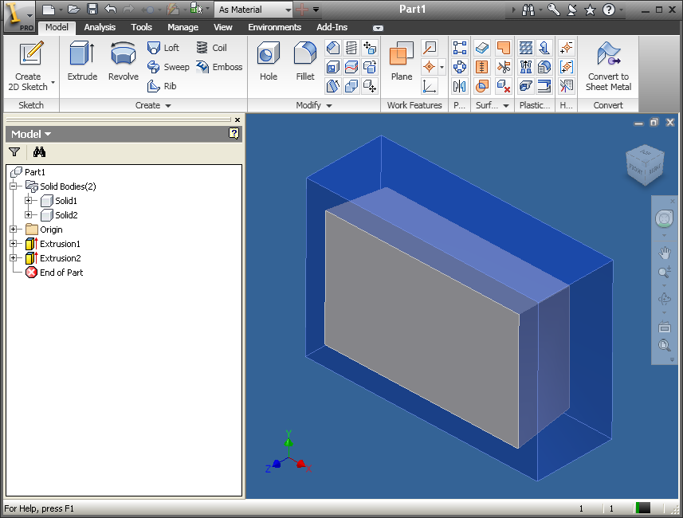
Multiple Solid Bodies in a Part
Support for multiple solid bodies within a single part.
SurfaceBodies collection returns more than 1 (In both Inventor and Apprentice).
Notes:
In all the previous releases of Inventor, if you created two extrusions, for example two cylinders, you would still just have a single solid body, albeit with two shells. It will now be possible to generate a new solid body out of the second extrusion.
Let’s have an overview of what could be some of the advantages of this enhancement:
The main purpose of this change is to make some solid operations a more intuitive workflow. For example, if you are removing a volume from a solid, it is easier to visualize and work with the volume as something that is there, rather than something that isn’t there. The users of AutoCAD Mechanical Desktop will recognize this approach and this is a good reason to help them moving to Inventor.

Slide 20
Creation of a new Body
New value added in the PartFeatureOperationEnum
kCutOperation
kIntersectOperation
kJoinOperation
kNewBodyOperation
kSurfaceOperation
Dim oExtrude As ExtrudeFeature
oExtrude = oPartDef.Features.ExtrudeFeatures.AddByDistanceExtent( _
oProfile, 1.5, kNegativeExtentDirection, kNewBodyOperation, "-5 deg")
Dim oRevolve As RevolveFeature
oRevolve = oPartDef.Features.RevolveFeatures.AddByAngle( _
oProfile, oWorkAxis, agl, kNegativeExtentDirection, kNewBodyOperation)
Notes:
'/////////////////////////////////////////////////////////////////////////////////////////////////////////////
'// Use: Multi Solid Bodies
'//
'/////////////////////////////////////////////////////////////////////////////////////////////////////////////
Public Sub CreateMultiBodies()
Dim oPartDoc As PartDocument
Set oPartDoc = ThisApplication.ActiveDocument
Dim oPartDef As PartComponentDefinition
Set oPartDef = oPartDoc.ComponentDefinition
' Create a sketch.
Dim oSketch As PlanarSketch
Set oSketch = oPartDef.Sketches.Add(oPartDef.WorkPlanes.item(3))
Dim oTG As TransientGeometry
Set oTG = ThisApplication.TransientGeometry
' Draw a rectangle and extrude it to create a new body.
' *** The kNewBodyOperation type of operation is new in Inventor 2010.
Call oSketch.SketchLines.AddAsTwoPointRectangle( _
oTG.CreatePoint2d(-3, -2), _
oTG.CreatePoint2d(3, 2))
Dim oProfile As Profile
Set oProfile = oSketch.Profiles.AddForSolid
Dim oExtrude As ExtrudeFeature
Set oExtrude = oPartDef.Features.ExtrudeFeatures.AddByDistanceExtent( _
oProfile, 2, kNegativeExtentDirection, kNewBodyOperation)
' Create a second sketch.
Set oSketch = oPartDef.Sketches.Add(oPartDef.WorkPlanes.item(3))
' *** The kNewBodyOperation type of operation is new in Inventor 2010.
' Draw a rectangle and extrude it to create a new body.
Call oSketch.SketchLines.AddAsTwoPointRectangle( _
oTG.CreatePoint2d(-2.5, -1.5), _
oTG.CreatePoint2d(2.5, 1.5))
Set oProfile = oSketch.Profiles.AddForSolid
Set oExtrude = oPartDef.Features.ExtrudeFeatures.AddByDistanceExtent( _
oProfile, 1.5, kNegativeExtentDirection, kNewBodyOperation, "-5 deg")
End Sub

Slide 21
Notes for Multi-Solid Parts
Split Feature – Can specify body(s) to split.
Stitch Feature – Specify if result is surface or solid.
Pattern allows patterning of specified body(s).
SurfaceBody.Visible is saved with the document.
SurfaceBody has a name.

Slide 22
Affected Bodies control
API uses a default body when creating new features. May need to change the affected bodies if needed.
PartFeature.SetAffectedBodies sets all bodies impacted by the feature.
PartFeature.SurfaceBodies returns all bodies impacted by the feature.
SurfaceBody.AffectedByFeatures
SurfaceBody.CreatedByFeature
PartComponentDefinition.HasMultipleSolidBodies
Notes:
When adding a feature through the API, Inventor will choose which body it applies to. You can then query the feature to see which body it was applied to and add other bodies or change bodies as needed.
Similarly, new features were added to SurfaceBody to allow you to query or edit which feature they were created from and which features they are affected by.

Slide 23
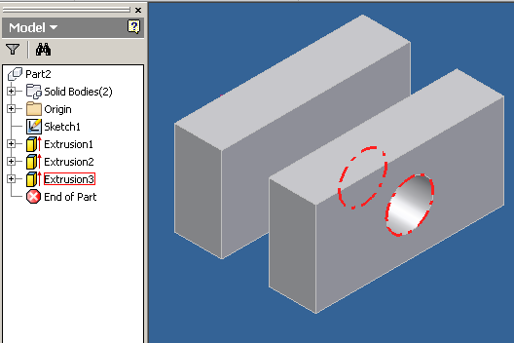
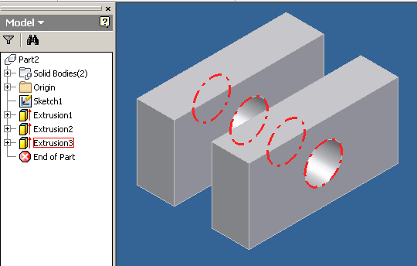
Affected Bodies control - Example
' Check to see if the feature affected all bodies.
If oExtrude.SurfaceBodies.Count <> oPartDef.SurfaceBodies.Count Then
Dim bodies As ObjectCollection
bodies = _InvApplication.TransientObjects.CreateObjectCollection
Dim body As SurfaceBody
For Each body In oPartDef.SurfaceBodies
bodies.Add(body)
Next
Call oExtrude.SetAffectedBodies(bodies)
End If
Notes:
Public Sub FeatureMultibody()
Dim oPartDoc As PartDocument
Set oPartDoc = ThisApplication.ActiveDocument
Dim oPartDef As PartComponentDefinition
Set oPartDef = oPartDoc.ComponentDefinition
' Create a sketch.
Dim oSketch As PlanarSketch
Set oSketch = oPartDef.Sketches.Add(oPartDef.WorkPlanes.Item(3))
Dim oTG As TransientGeometry
Set oTG = ThisApplication.TransientGeometry
' *** The kNewBodyOperation type of operation is new in Inventor 2010.
' Draw a rectangle and oExtrude it to create a new body.
Call oSketch.SketchLines.AddAsTwoPointRectangle( _
oTG.CreatePoint2d(-4, -2), _
oTG.CreatePoint2d(-3, 2))
Dim oProfile As Profile
Set oProfile = oSketch.Profiles.AddForSolid
Dim oExtrude As ExtrudeFeature
Set oExtrude = oPartDef.Features.ExtrudeFeatures.AddByDistanceExtent( _
oProfile, 2, kSymmetricExtentDirection, kNewBodyOperation)
' Create a second sketch.
Set oSketch = oPartDef.Sketches.Add(oPartDef.WorkPlanes.Item(3))
' *** The kNewBodyOperation type of operation is new in Inventor 2010.
' Draw a rectangle and oExtrude it to create a new body.
Call oSketch.SketchLines.AddAsTwoPointRectangle( _
oTG.CreatePoint2d(-2, -2), _
oTG.CreatePoint2d(-1, 2))
Set oProfile = oSketch.Profiles.AddForSolid
Set oExtrude = oPartDef.Features.ExtrudeFeatures.AddByDistanceExtent( _
oProfile, 2, kSymmetricExtentDirection, kNewBodyOperation)
' Create a third sketch.
Set oSketch = oPartDef.Sketches.Add(oPartDef.WorkPlanes.Item(1))
' Draw a circle and oExtrude it to cut through the existing bodies.
oSketch.SketchCircles.AddByCenterRadius oTG.CreatePoint2d(0, 0), 0.5
Set oProfile = oSketch.Profiles.AddForSolid
Set oExtrude = oPartDef.Features.ExtrudeFeatures.AddByThroughAllExtent( _
oProfile, kNegativeExtentDirection, kCutOperation)
' *** The SurfaceBodies property on the feature
' *** and the SetAffectedBodies method are new in Inventor 2010.
' Check to see if the feature affected all bodies.
If oExtrude.SurfaceBodies.count <> oPartDef.SurfaceBodies.count Then
Dim bodies As ObjectCollection
Set bodies = ThisApplication.TransientObjects.CreateObjectCollection
Dim body As SurfaceBody
For Each body In oPartDef.SurfaceBodies
bodies.Add body
Next
Call oExtrude.SetAffectedBodies(bodies)
End If
End Sub

Slide 24

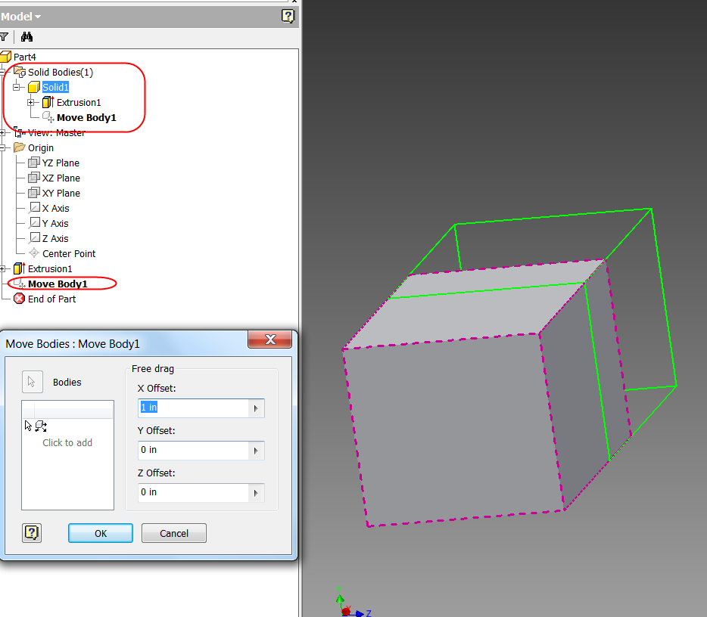
Move Feature query move feature
Public Sub MoveFeatureQuery()
Dim oPartDoc As PartDocument
oPartDoc = _InvApplication.ActiveDocument
Dim oPartDef As PartComponentDefinition
oPartDef = oPartDoc.ComponentDefinition
'get the first move feature
Dim oMoveFeature As MoveFeature
oMoveFeature = oPartDef.Features.MoveFeatures(1)
'get the translation vector of the move feature
Dim oTranslation As Vector
oTranslation = oMoveFeature.Transformation.Translation
'print the translation information
Debug.Print("- MoveFeature: Translation: [" & _
oTranslation.X & ", " & _
oTranslation.Y & ", " & _
oTranslation.Z & "]")
End Sub
Notes:
At the moment, unfortunately, the API offers a query-only support concerning the MoveFeature. Creation and Edit will be provided probably in the next release.

Slide 25
Move Feature create move feature
Creation is supported From Inventor 2013
Workflow is same to other features
Create definition
Add definition to the MoveFeatures collection
Public Sub CreateMoveFeature()
Dim oPartDoc As PartDocument
oPartDoc = _InvApplication.ActiveDocument
Dim oPartDef As PartComponentDefinition
oPartDef = oPartDoc.ComponentDefinition
'collect the faces to move
Dim oSolidColl As ObjectCollection
oSolidColl = _InvApplication.TransientObjects.CreateObjectCollection()
'add the first solid
oSolidColl.Add(oPartDef.SurfaceBodies(1))
'create move feature definition
Dim oMoveFDef As MoveDefinition
oMoveFDef = oPartDef.Features.MoveFeatures.CreateMoveDefinition(oSolidColl)
' Define a rotate, move, and free drag.
oMoveFDef.AddRotateAboutAxis(oPartDef.WorkAxes(3), True, 3.14159265358979 / 4)
oMoveFDef.AddMoveAlongRay(oPartDef.WorkAxes(1), True, 3)
oMoveFDef.AddFreeDrag(0.5, 6, 3)
'create the move feature
Dim oMoveF As MoveFeature
oMoveF = oPartDef.Features.MoveFeatures.Add(oMoveFDef)
End Sub

Slide 26
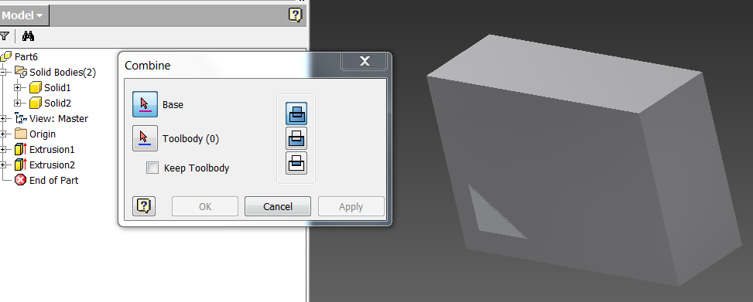
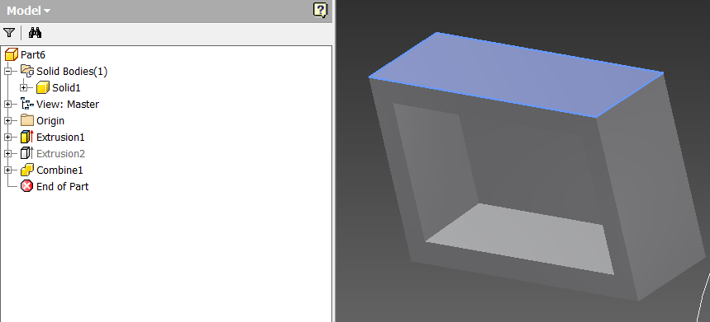
Combine Solids
e.g. before combine
after combine with cut mode

Slide 27
Combine Feature example
Public Sub CombineBodies()
Dim oPartDoc As PartDocument
oPartDoc = _InvApplication.ActiveDocument
Dim oPartDef As PartComponentDefinition
oPartDef = oPartDoc.ComponentDefinition
'add first body
Dim oBaseBody As SurfaceBody
oBaseBody = oPartDef.SurfaceBodies(1)
Dim oToolBodies As ObjectCollection
oToolBodies = _InvApplication.TransientObjects.CreateObjectCollection
'add second body
oToolBodies.Add(oPartDef.SurfaceBodies(2))
Dim oCombineFeature As CombineFeature
oCombineFeature = oPartDef.Features.CombineFeatures.Add( _
oBaseBody, _
oToolBodies, _
PartFeatureOperationEnum.kCutOperation, _
False)
End Sub
Notes:
a full API support is provided concerning the new CombineFeature. The code below, run on our actual part, will create a Boolean Cut operation between our two bodies.
Typically, the “CombineFeatures.Add” method will take as input one body considered as the “base” body and a collection of one or several “tool” bodies to perform the Boolean operation.

Slide 28
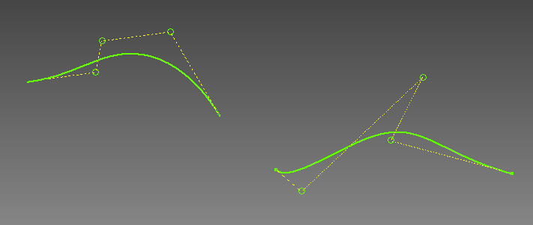
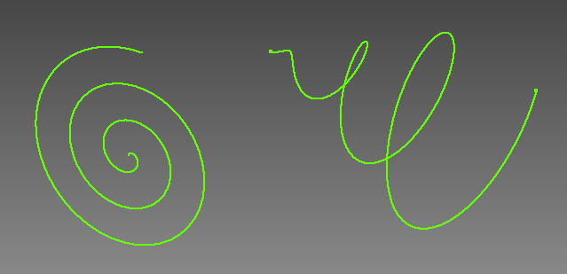
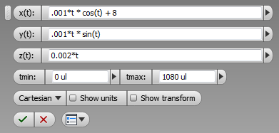
Sketch – Splines (from 2014)
Full API support for control point splines in 2D and 3D.
Full API support for equation curves in 2D and 3D.
Notes:
This is added in 2013 in ui, and now we added API support. In the past, we have only one way to create the spline by providing its points. Now, you can provide control points in a term of polyline. Inventor can draw spline with them. It is avaible in 2d or 3d.
Another is equation curve, you can define a 2d or 3d equationto draw the curve
The API now supports full creation and edit of control point spline and equation curves for both 2D and 3D sketches.

Slide 29
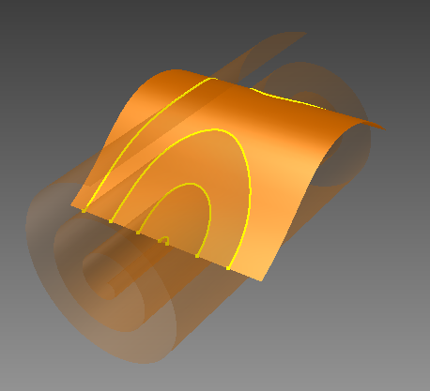
Sketch – 3D Intersection Curves (from 2014)
Full API support for intersection curves in a 3D sketch.
Notes:
This is also an abilyt added in the previous release and now supported by API
You can fine the interection of the surface and surface and create
3d sketch curves.
It is now all posible in API

Slide 30
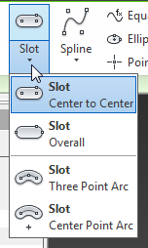
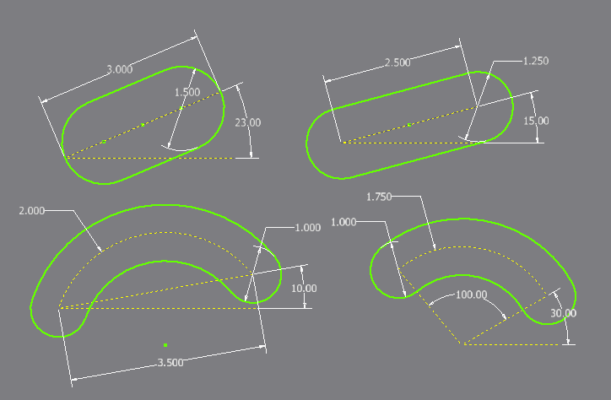
Sketch – Slots (from 2014)
New slot commands in sketch.
Full API Support.
Notes:
This is the new abilty of product and is avaible with API
Slot in sketches. The result is just a start, for convenient.
Somebody has requested such api a few releasea ago.

Slide 31
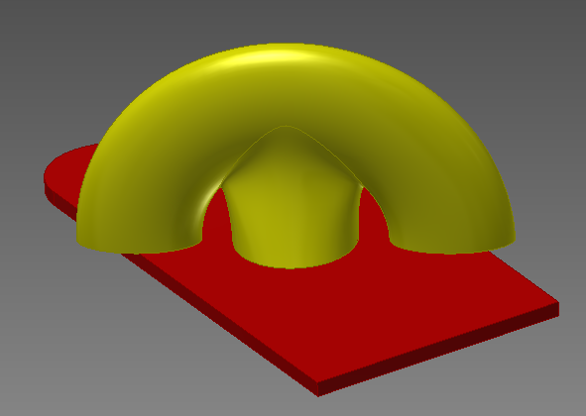
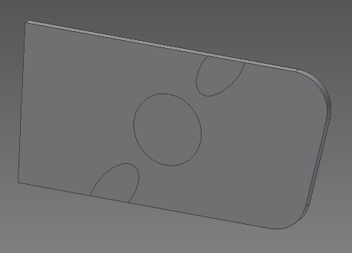
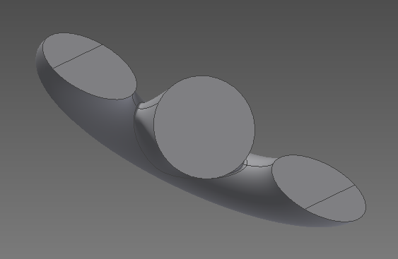
Imprinting (From 2014)
API only
Typically used in analysis application for matching
TransientBRep.ImprintBodies
Input two bodies, return the new bodies and overlapped faces, edges
Notes:
In parts, not too much. You can create workpoint at center of shphere. Control the patches weights.it is new in product and also API as well.
And also new function, API only is impritng. Not common use many developer
By comanny by some type s of analisys application that doing mesh as a solid, get better mesh , no gurantte where is the part connect. no here two two new body, transient
Two new bodies. Faces is spli with the part connected.

Slide 32
Consistent Materials – What’s Gone
The RenderStyle object is no longer used.
Hidden
Continues to function but should begin using new API
Not officially supported
The Material object is no longer used.
Hidden
Continues to function but should begin using new API
Not officially supported
Related methods and properties on other objects are hidden.
GetRenderStyle
SetRenderStyle
Material
Etc.
Notes:
So last relase intrduce we did not do anything wit API . The rendder stle aPI unheth it has limited access, most of seems ok, but not all. We expose the cm
The renderstyle is still there but we do not offical support anymore. now all old objects and methods are hidden.

Slide 33
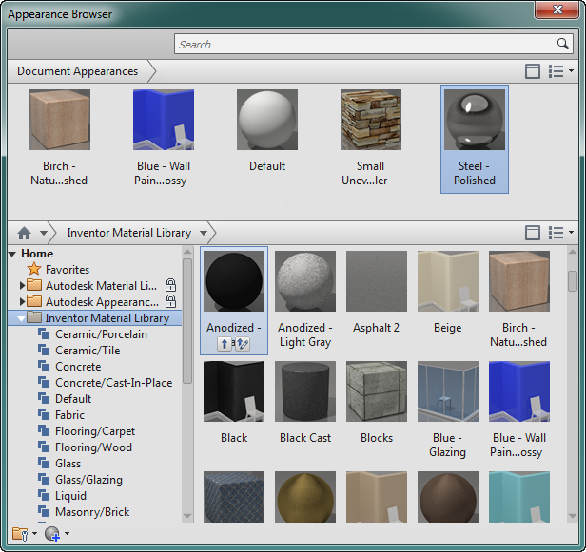
Consistent Materials – What’s New
Full API access to the new materials and appearances.
Consistent materials is more powerful and complex.
API is complex that previous API.
Notes:
CM has a lot of possbility but complex. Render style object, find the renderstly.e color, it is easy to know , create a new one.
It is not so easy as the old methods.
This is not the cae anymore . The way that we expose have a lib autodesk common libs, Lib across autodesk products. Libs contains assets. The contain Assets that can be aprranece or be a mateial. Asset is Just list of named values. Depens on the assest , So it is get a little complecaite
You have a librairies of collections of assets.
Very depends on what assets is
It is not self-document , desribing each type.
Also have a document assets. Be used to apply color to a face, then when you ar
Ding un the ui, you have ti list what is avaible in the document.
aPI can access the document, then this is just high level. Document is well written

Slide 34
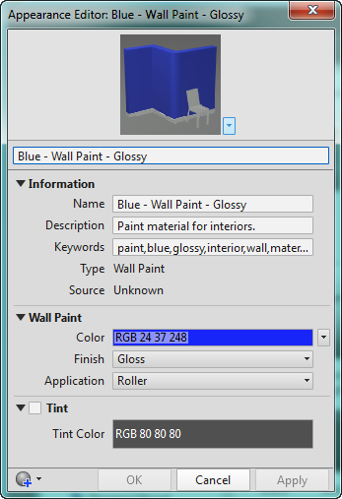
Consistent Materials – Continued
Library and Document assets.
Only Document assets can be edited and used.

Slide 35
Consistent Materials – Continued
Materials, Physical Properties, and Appearances are “Assets”.
An asset is a collection various types of named values:
Boolean
Choice
Color
Filename
Float
Integer
Reference
String
Texture
Notes:
Materials simplest assets. Name: combine the two: color,
Different types will values. For the middle. That will be documented.

Slide 36

Notes:
Thank you!
Questions?

